Slide 1
AngNet User Demo
Hyuk Jin Kwon
Hyukjkwon@gmail.com

Slide 2
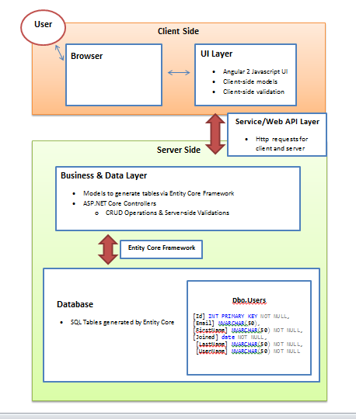
Architecture

Slide 3
Errors and Potential Fixes

Slide 4
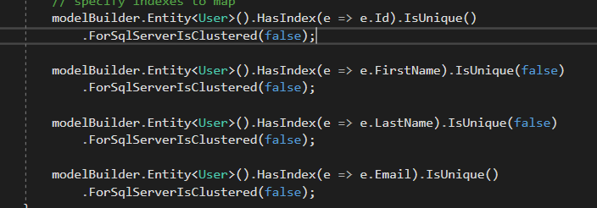
Indexes on Names
Name indexes were set to unique, causing errors in server-side validation
Any duplicate first and last name
Ex. “Steve Wilkos” and “Steve Jobs” cannot exist
Ex. “Bob Ross” and “Art Ross” cannot exist
Thus indexes on first and last names were set to non-unique

Slide 5
Server-Side Validation
Currently designed with only duplicate entry validation in mind
Future considerations:
Malformed JSON Data
Empty content

Slide 6
Front-End

Slide 7
Angular 2 Important Classes
Components
User-table
Contains list of users
User-summary
User summaries within the table
Modal-popup
Displays current or intakes new user information
Directives
User-type
Client-side user class definition

Slide 8
Other Angular Elements
User-Service
Contains HTTP Requests to server
Handles server data on front-end
Filter
Allows searching of users displayed on client-side

Slide 9
Web API Layer

Slide 10
User-Service.ts
Get Request: getUserList()
Requests JSON data from controller and interpreted as user-type class
Post Request: addUser()
Stringify to JSON, then sends off to controller
Receives new valid JSON user list or a bad request
Bad requests are handled with an alert message

Slide 11
DBController
GetUserList()
Gets User list from database
AddUser()
Checks to see if a duplicate user exists
If valid, user is added and updated list is requested by GetUserList()
Invalid request sends a bad request, then unedited list is requested

Slide 12
Business and Data Access Layer

Slide 13
Business & Data Layer
Mapped using Entity Core Framework (ORM)
Settings and behaviour found in UserContext.cs

Slide 14
UserContext.cs
If not already created, the configuration for a new database is found here
Connection string is set here via appsettings.json file
Indexes can also be created here

Slide 15
DataBase

Slide 16
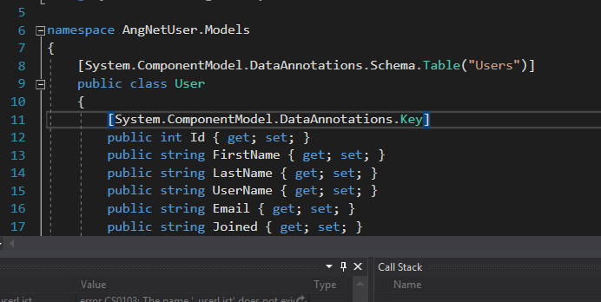
Entity Core Framework
Maps C# classes to SQL server definitions
User.cs defines properties like normal OO classes
Defines keys, and types associated with SQL

Slide 17
New Core Shortcomings
ASP.Net Core and Entity Core are not complete
Does not handle database migration well if schema already exist
Means databases and tables must be created through visual studio solution code, and not by SQL scripts
Web Config is no longer used
Connection strings and other project information has now been moved to appsettings.json

